Slide 1
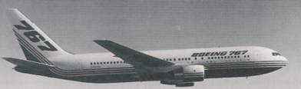
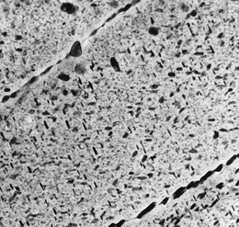
재료의 강화
1. Solid Solution Strengthening
• Impurity atoms distort the lattice & generate stress.
• Stress can produce a barrier to dislocation motion.
Smaller substitutional impurity
Larger substitutional impurity
A
C
B
D
2. Precipitation Strengthening
• Hard precipitates are difficult to shear.
Ex: SiC in Aluminum.
precipitate
Side View
Top View
Unslipped part of slip plane
S
spacing
Slipped part of slip plane

Slide 2
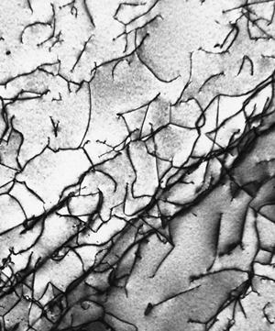
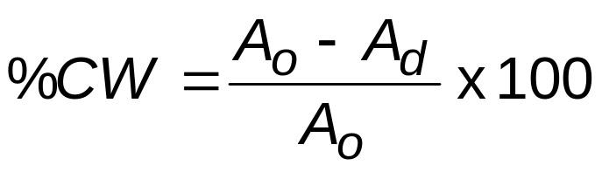
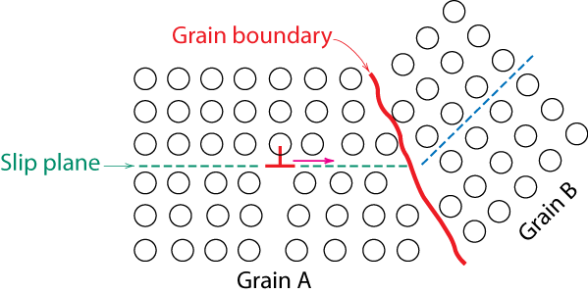
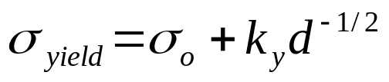
3. Cold Work Strengthening
- Room temperature deformation.
Common forming operations change the cross sectional area:
-Rolling
roll
A
d
A
o
roll
Dislocations entangle with one another during cold work.
Dislocation motion becomes more difficult.
0.9 μm
4. Grain Size Strengthening
Smaller grain size: more barriers to slip.
Hall-Petch Equation:

Slide 3
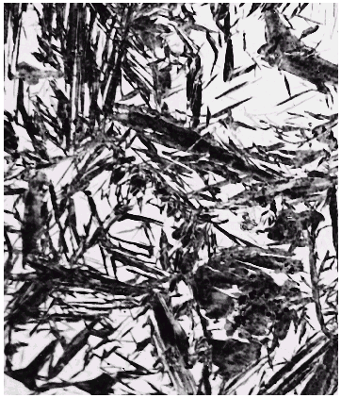
Martensite: Fe-C System
• Martensite:
--γ(FCC) to Martensite (BCT)
(involves single atom jumps)
Fe atom
x
potential
sites
x
x
60 μm
x
x
C atom sites
x
• Isothermal Transf. Diagram
800
Martensite needles
Austenite (stable)
Austenite
T(°C)
T_{E}
A
P
600
400
A
B
• γ to M transformation..
-- is rapid!
-- % transf. depends on T only.
100%
0%
50%
200
M + A
0%
M + A
50%
M + A
90%
10
-1
10
10
3
10
5
time (s)

Slide 4
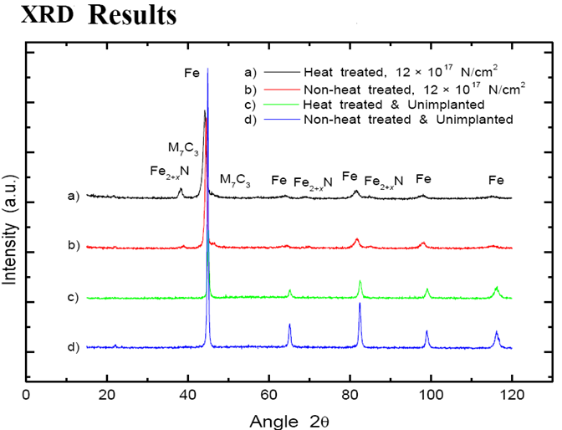
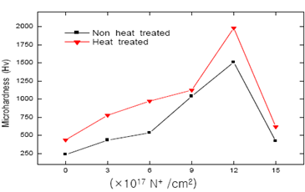
PIII&D
Plasma-immersion ion implantation

Slide 5
